Slide 1
PROJECT DOOR STEP
Sydney
Office Visit- February 28-29, 2000
Report Issued- March ___, 2000
Confidential

Slide 2
Project Doorstep-Sydney
Review Highlights
Project Objective:
We performed an on-site review of processes, procedures and controls that support the trading and origination business activities within the Sydney office. Our procedures included interviews with key commercial and accounting personnel. We also performed a test of commodity transactions from deal execution through settlement.
Team Members: Office Personnel Interviewed:
Bill Bradford - RAC Paul Quilkey - Office Manager
Rudi Zipter - RAC Harold Levy - Trader (Power )
Scott Earnest - Risk Management Harry Papadopolos - Trader (Coal)
Tom Bauer - AA John Bowman - Trader (ST Power)
Jim Brown - AA David Minns - Sr. Legal Counsel
John Vickers - AA Raymond Yeow - Director Structuring
Heidi Mason - Director Financial Operations
Paul Smith - Manager Risk Management
Allan Ford - Manager Risk Management
Steve Love - Director Origination

Slide 3
Project Doorstep-Sydney
Current Portfolio
Power
OTC power swaps make up the majority of remainder of the portfolio.
Swap activities include fixed for float swaps and capped swaps
which are traded in 5 regions
Settlement Residue Auctions (SRA’s - a regional basis spread
position) - SRA’s comprise approximately 50% of the value of Sydney’s power portfolio.
These SRA’s are primarily Victoria to South Australia positions
  Due to unusual market conditions (labor strike in Victoria) the value of the Victoria to South Australia SRA’s has significantly decreased and the option premium is expected to decay at a rapid rate
  The traders expect to hold the SRA position into liquidation from the spread-option valuation model. This implies that the remaining extrinsic value will decay at a rate of $80,000/day through the first quarter of 2000
2-29-00
NOP (0.2)MM MWh
V@R $228,000
YTD P/L ($.8)MM

Slide 4
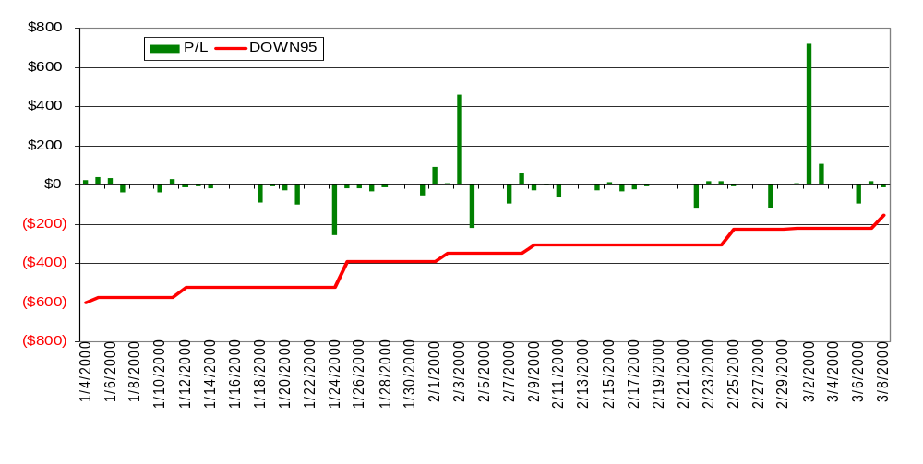
Australia V@R vs. P/L
Project Doorstep-Sydney
Current Portfolio
RoV@R = -3% SHARPE RATIO = -8%

Slide 5
Project Doorstep-Sydney
Current Portfolio
Power (cont.)
Futures traded on the Sydney Futures Exchange are very illiquid and the company has minimal participation in these contracts
1 contingent caption (a purchased option which pays only when prices are greater than A$ 200/mwh and an Interconnect Event occurs) extending through June 2000
1 PJM to Victoria power basis swap was executed in 1999 and has already liquidated. The PJM leg was swapped to ENA (Fallon) concurrently with the initial trade
* DEAL TEST- 1 SRA, 1 contingent caption, 8 power deals
Other
1 Financial jet deal - swapped to Singapore
3-5 Coal deals executed in 1999 (captured in London)
Minimal F/X transactions
* DEAL TEST- 1 Jet deal, 1 coal deal, 1 FX deal
Rudi to insert pg (graph) after this

Slide 6
Project Doorstep - Sydney
Observations
EFFECTIVE CONTROLS
Office Manager has a strong presence among the local traders (except for coal)
Back office records are easy to access and well organized
Director of Structuring and reviews all confirms
Non-Austraclear disbursements/receipts occur in Houston
Houston back office signs off on confirms
Enpower is installed as the electricity trading system

Slide 7
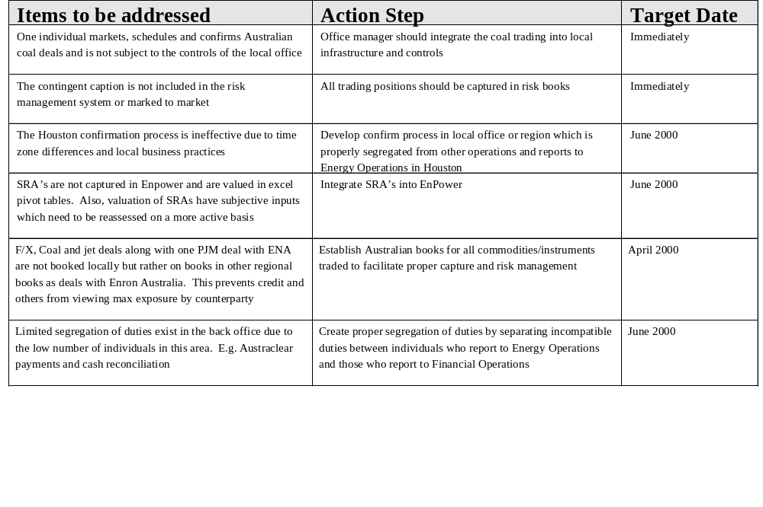
Project Doorstep - Sydney Observations

Slide 8
Project Doorstep - Sydney
Observations
OUTLOOK
Full contestability for retail customers could increase transaction flow and stress business
processes
Acquisition of generating assets would create a complex scheduling/bidding process which
does not currently exist
It is expected by local Management, that weather trading would be highly successful (no
current trades)
Both Singapore and Sydney believe that with the addition of the Japan office, an Asia/Pacific
back office hub (at one of the 3 locations) would be beneficial
Broadband is coming to Asia/Pacific

Slide 9
Project Doorstep - Sydney
Office Analysis Framework
Market Structure
Primarily financial power deals and SRAs
Sophisticated trading environment
Strong preference to deals with other Australian
entities
Local exchange traded contract exists
Full contestability within two years
Power pool for bidding generation
Management
Office Manager gives a strong Enron
presence
Other functional heads are primarily locals
    Cooperative
    Competent
    Professional
Systems
Enpower (power trading)
Sun (accounting)
Austraclear (settlements)
Various spreadsheets
Previously on Power 97
Information
Daily position reports
Monthly accounting package
Benchmark reports

Slide 10
Project Doorstep - Sydney
Office Analysis Framework
Strategy
Trade electricity within and between the
various Australian regions
Develop Weather market
Own generating assets
Penetrate the electric-retail market when full
contestability is available
Counterparties
Counterparties are preapproved for trading
Mostly large international energy companies
NEMMCO (the National Electricity Market Management Company) is the counterparty to SRA’s
Competitors
Mostly large international energy companies
Local generation owners
Business Processes
Back-office coordination between Houston and Sydney
Austraclear settlements in Sydney
Other settlements in Houston
Confirms in Sydney/Houston
Risk management and structuring in Sydney
Credit approval in Houston

